Slide 1
LAB – 5 : SOLUTION OF ODE OF FIRST ORDER AND FIRST
DEGREE BY RUNGE-KUTTA 4TH ORDER METHOD
AND MILNE’S PREDICTOR AND CORRECTOR METHOD
RUNGE-KUTTA 4TH ORDER METHOD

Slide 3
MILNE’S PREDICTOR AND CORRECTOR METHOD

Slide 4
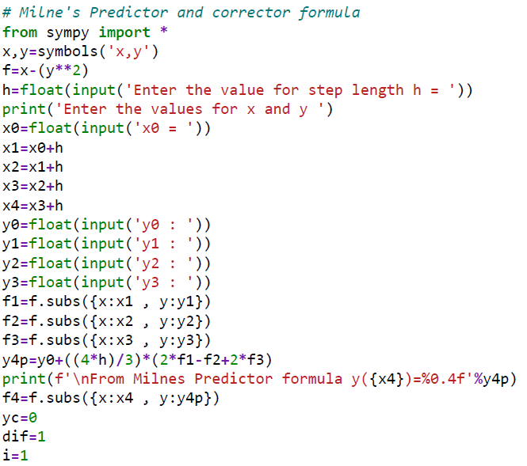

Slide 5
